Slide 1
Space Elevator - Concept, Technology, Financial
Viability & Safety Issue
London September 2021

Slide 2
Introduction
Most people see the concept of space elevator in films
A space elevator is a cable with one end attached to the Earth, while the other end into space
Rockets are the only means of transportation into space
This study establishes a contemporary perspective on the current state of the art on space elevators

Slide 3
A Space elevator
Idea first proposed by Constantin Tsiolkovsky, in 1895.
A space elevator is a geostationary connection built from the Earth's surface to an orbit altitude of approx. 36,000km
A means of transportation from earth into space

Slide 4
Rationale of the Study
The concept is informed by the desire to establish a more sustainable way of space travel
The study presents the viability of space travel in a space elevator
Based on the current state of
    science and technology
    safety issues
    financial viability

Slide 5
Research Objectives
1. What are the managerial risks currently associated with the construction of a space elevator?
2. What are the financial risks associated with the construction of a space elevator?
3. What are the existing safety risks associated with space elevators, and what are their remedies?
4. To what extent is a space elevator project financially viable?

Slide 6
Review Designs
Descriptive reviews
Narrative reviews
Realistic reviews Literature Review
Scoping reviews
Systematic reviews

Slide 7
Analytical Themes: Viable designs for an effective space elevator
A space elevator would eradicate the need for rockets
There is a lack of consensus on the most appropriate concept for its development
Proposed concepts
  Modern Space elevator model
  Climber Model
  Base Station Concept

Slide 8
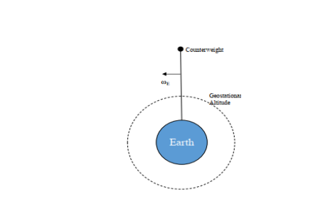
Modern Space Elevator Model

Slide 9
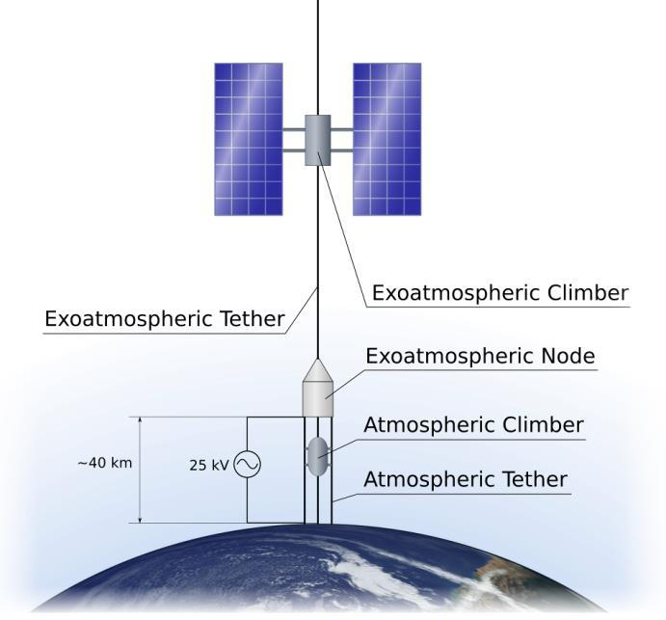
Climber Model

Slide 10
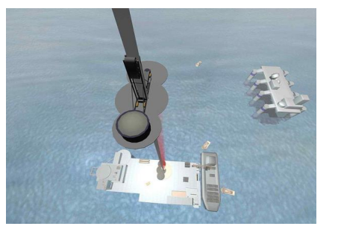
Base Station Concept

Slide 11
Existing and futuristic materials for the construction of a space elevator
Unrealistic designs have hampered the development of the space elevator.
Materials required:
  Carbon nanotubes (CNTs)
  Graphene
  The discovery of single-crystalline graphene at the Peking University marks a significant milestone

Slide 12
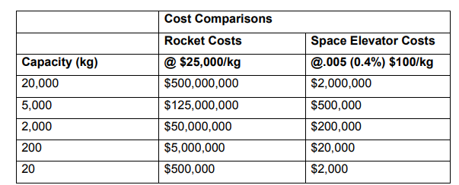
Economic viability of space elevators
Cost comparisons between rockets and space elevators

Slide 13
Management risks associated with a space elevator
Lack of vision and mission
A vision is integral to sustaining constant forward motion
Collaborative efforts required for realization of the project

Slide 14
Safety risks associated with the development of a space elevator
Hazards ensuing from potential collisions between the elevator structures and other objects
Catastrophic failure due to triggers such as temperature variations and excessive vibrations
Incorporation of multiple backup modes required

Slide 15
Discussion of Findings
The objectives of the study have been accomplished.
An exciting vision will be a vital tool for maintaining goodwill towards the project
Required materials such as CNTs and grapheme are still in their formative stages
On security, backup modes will be required
Successful completion of a space elevator would promise to offer monumental benefits to space exploration endeavors

Slide 16
Conclusion
Research objectives met
In-depth understanding of the key factors in undertaking a space elevator project considered
Evaluation of the different factors identified requires in-depth research

Slide 17
Recommendations
The research on the space elevator concept is largely fragmented
Need for a more concerted effort to amalgamate the existing studies across diverse fields

